Slide 1
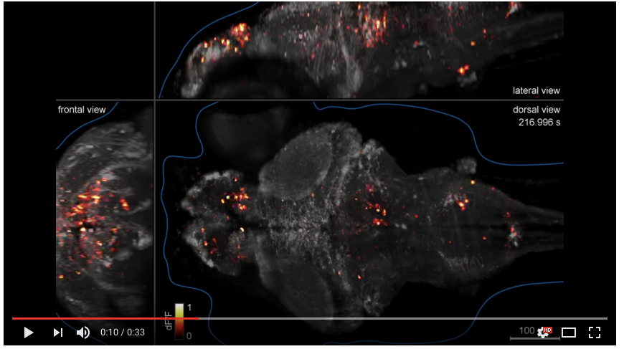
Imaging Calcium (CA) Signaling
Zebrafish embryo expressing GCaMP in the brain, light sheet microscopy (Keller group, HHMI-Janelia)
Ahrens et al 2013 Nature Methods

Slide 2
Objectives
What are the roles of CA in the cell?
How are CA levels regulated in the cell?
Entry/removal
Buffering
What are tools we have for visualizing CA levels and dynamics in vivo?
Types of indicators
Pros/Cons
How to read the data

Slide 3
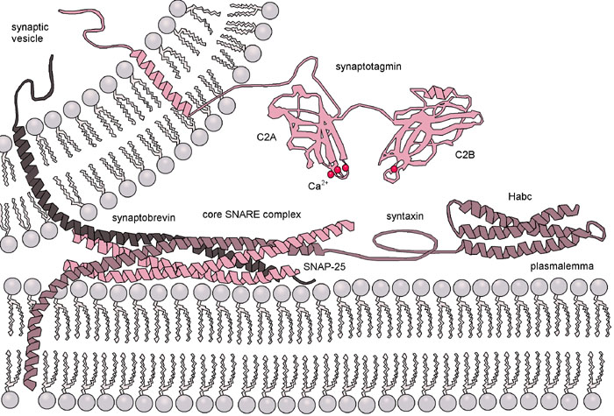
Calcium Signaling
Kinase activation
Phosphatase activation
Gene expression
Metabolism
Cell death
Glial calcium waves
Neuronal chemical neurotransmission
Excitability
Signal Integration

Slide 4
Calcium levels are tightly regulated
[Ca²⁺]_{i} = 50-100 nM in resting neurons
This level is achieved through the balance of:
Influx/efflux at the plasma membrane
Influx/efflux at organelles
Binding/release at sequestering proteins
3. Only free [Ca²⁺]_{i} is biologically active
Want to limit CA signaling in time and space – critical for a signaling molecule that has so many different roles.
Grienberger & Konnerth Neuron 2012

Slide 5
Calcium dynamics: entry
From extracellular space
Voltage-gated CA channels
Ionotropic glutamate receptors (non-specific)
G-protein coupled receptors (indirect)
Transient receptor potential channels
From organelles:
Inositol triphosphate receptor
Ryanodine receptors (Ca-induced Ca release)
Sodium-calcium exchanger
The expression level and organization of channels and receptors in space can have a big effect on the localization of calcium entry.

Slide 6
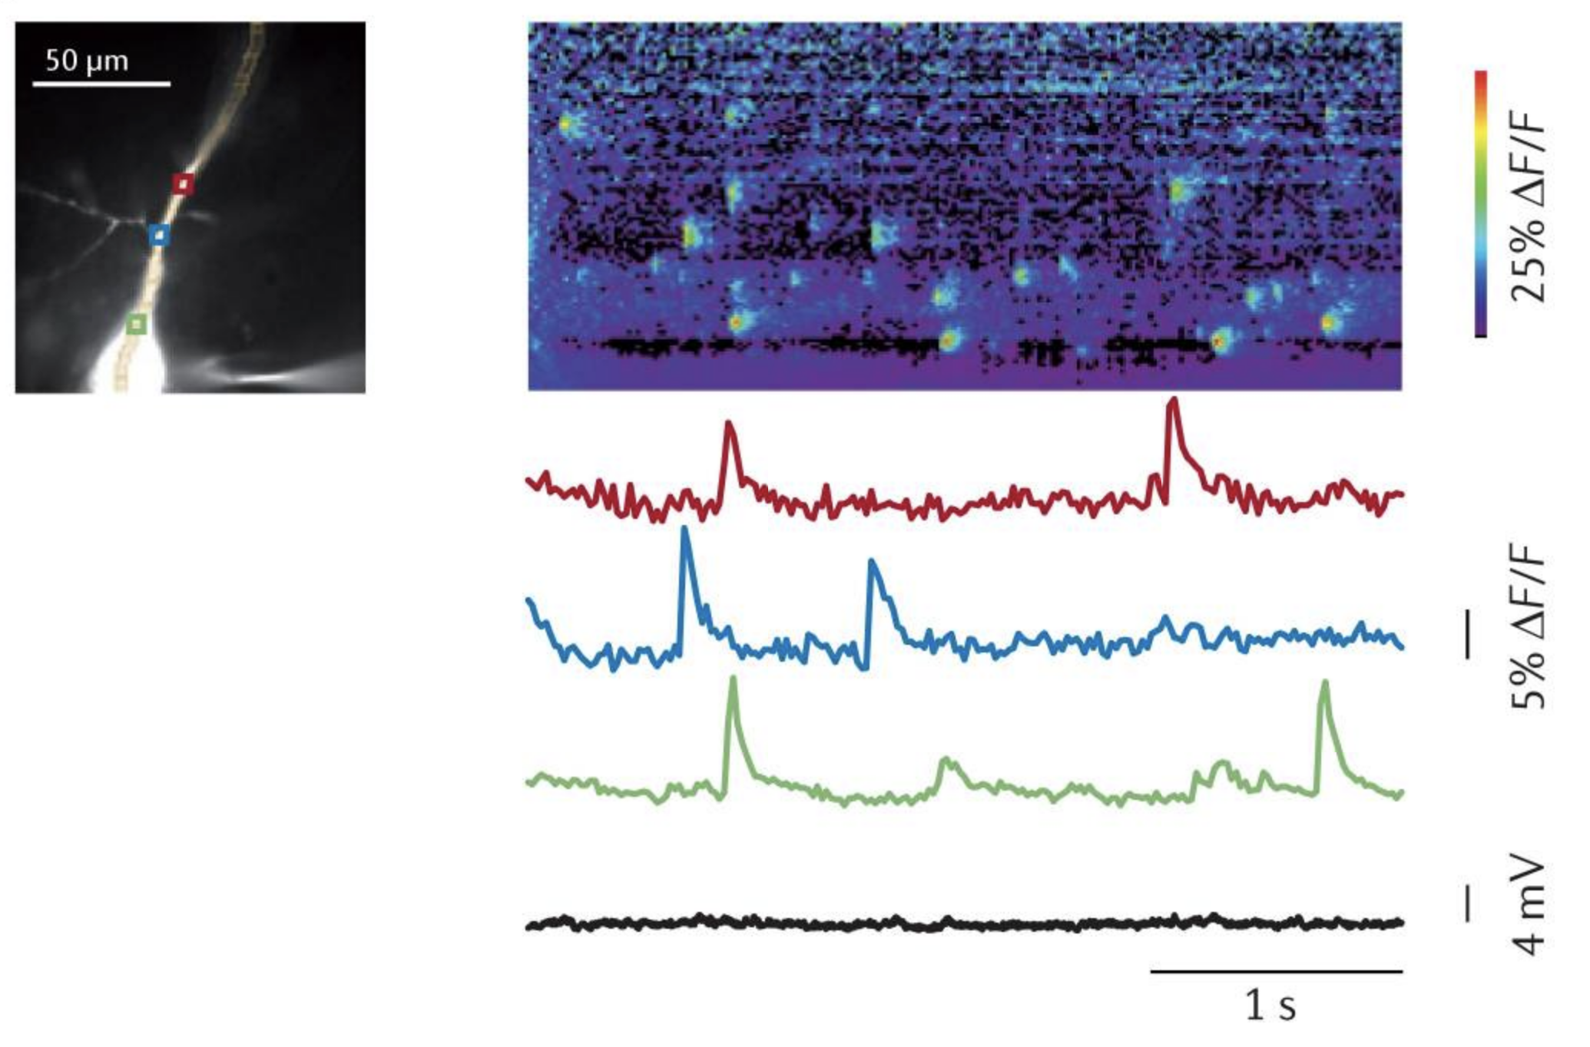
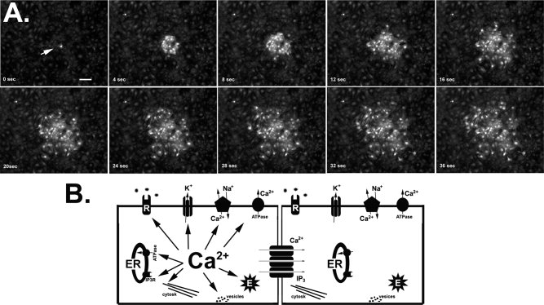
Calcium dynamics: sparks, puffs, and waves
Defined by: dynamics (time, space); means of entry (RyR vs IP3R+gap junctions)
Ross, 2012 Nat Rev Neuro
Scemes & Giaume, 2006 Glia

Slide 7
Calcium dynamics: removal
To extracellular space
Sodium-calcium exchangers
Plasma membrane calcium ATPase
To organelles:
Sarco-/endoplasmic reticulum calcium ATPase
Calcium uniporters
Buffers (calcium binding proteins) effectively reversibly remove calcium from the intracellular space
(e.g., parvalbumin, calbindin-D28k, calretinin)
Notes:
7

Slide 8
Tools for visualizing calcium
Chemical-based (Dyes)
Ratio-metric
Protein-based
Bioluminescence
Genetically encoded
two fluors (FRET)
single fluor (cpGFP)
single wavelength

Slide 9
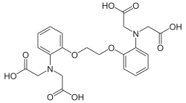
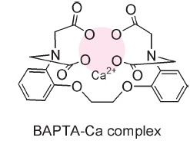
BAPTA
1,2-bis(o-aminophenoxy)ethane-N,N,N’,N’-tetra-acetic acid
Ca²⁺

Slide 10
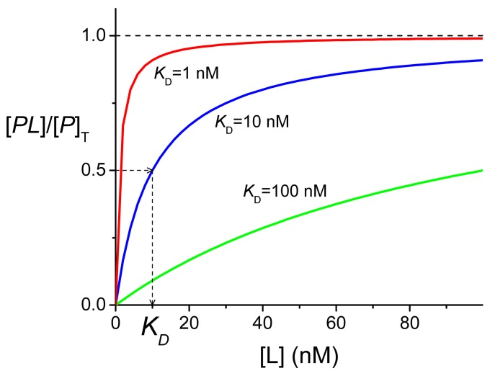
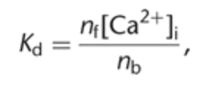
K_{D} : how well an indicator binds Ca²⁺
Normalized fluorescence intensity
n_{f} = molar amount free dye
n_{b} = molar amount bound dye
[Ca²⁺], nM
K_{D} corresponds to the concentration of calcium at which half the indicator molecules are bound with calcium at equilibrium.

Slide 11
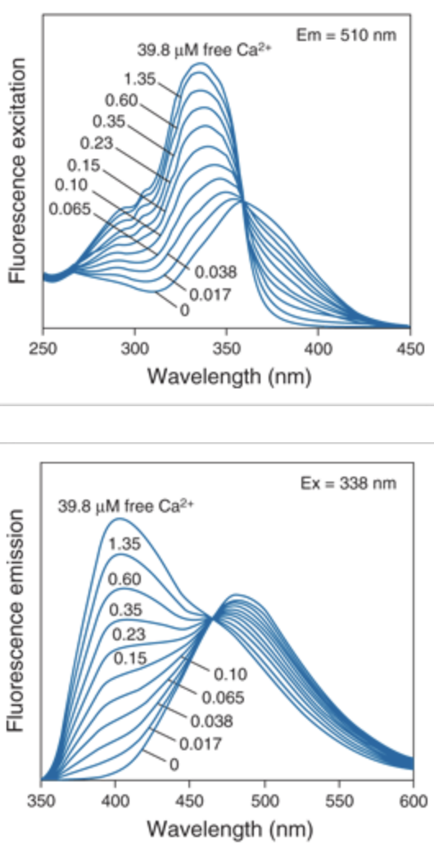
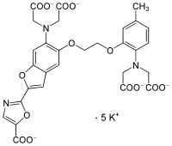
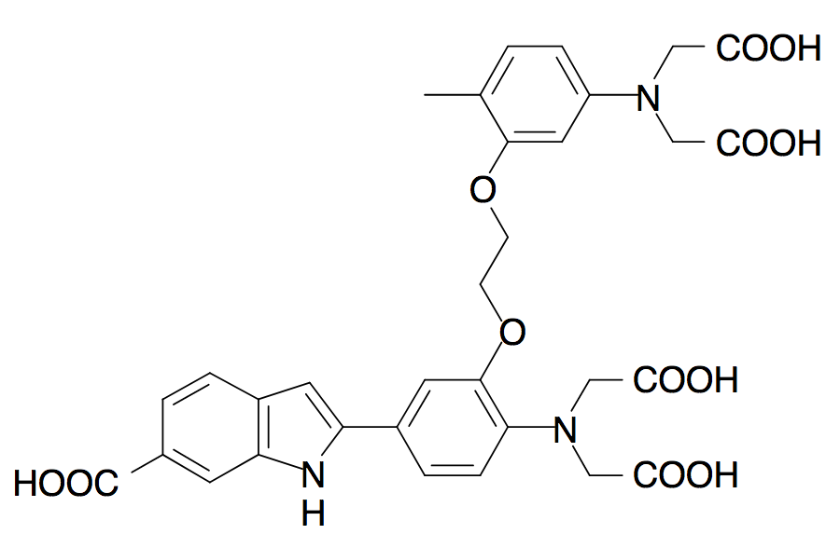
Ratio-metric calcium dyes: fura2, indo1
FURA-2
K_{d}~135 nM
INDO-1
K_{d}~230 nM
Notes:
11

Slide 12
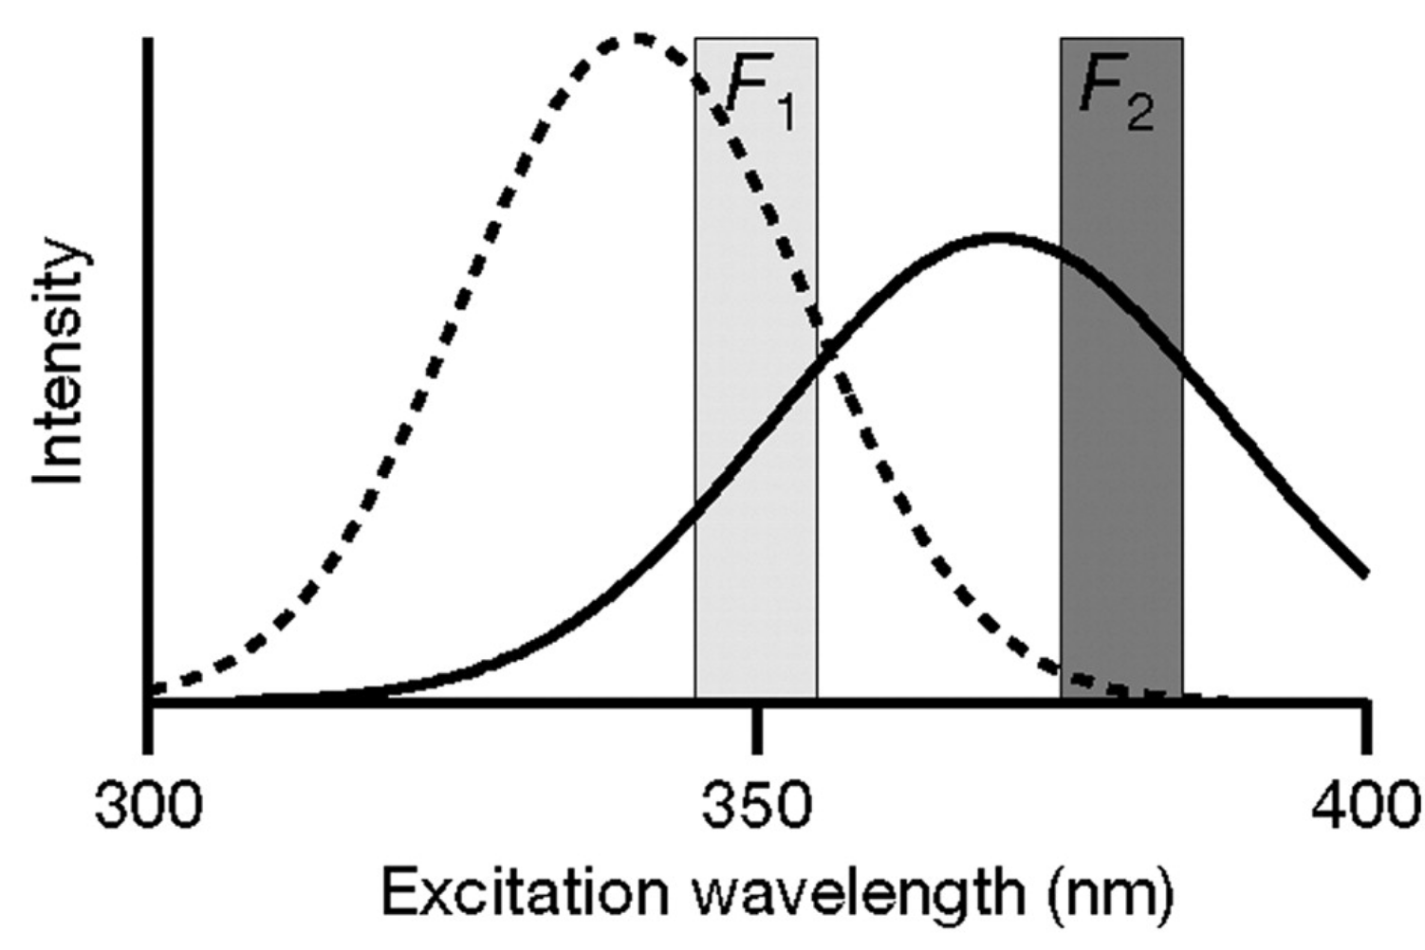
Ratio-metric calcium dyes: fura2, indo1
Helmchen, 2010 CSHP

Slide 13
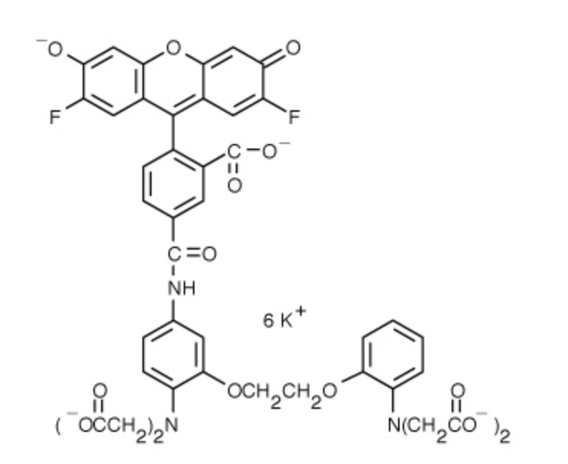
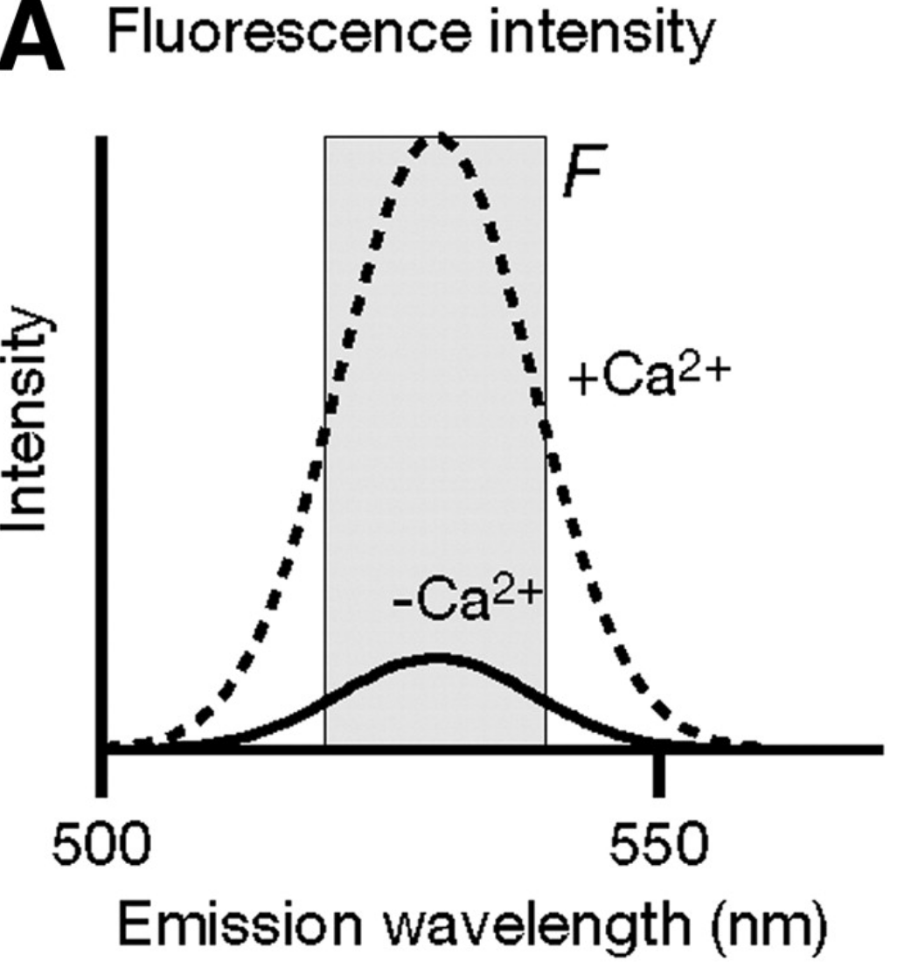
Single wavelength: fluo4, oregon green bapta, etc
Oregon Green BAPTA-1
Ex/Em: 494/523nm
Fluorescence increases ~14 fold in the presence of calcium
You will often see data reported as dF/F₀

Slide 14
Dye-loading Procedures
AM-Ester Loading
Diffusion from patch-clamp pipettes
Microinjection
Diffusion through gap junctions
Induced permeabilization (electroporation, ATP)

Slide 15
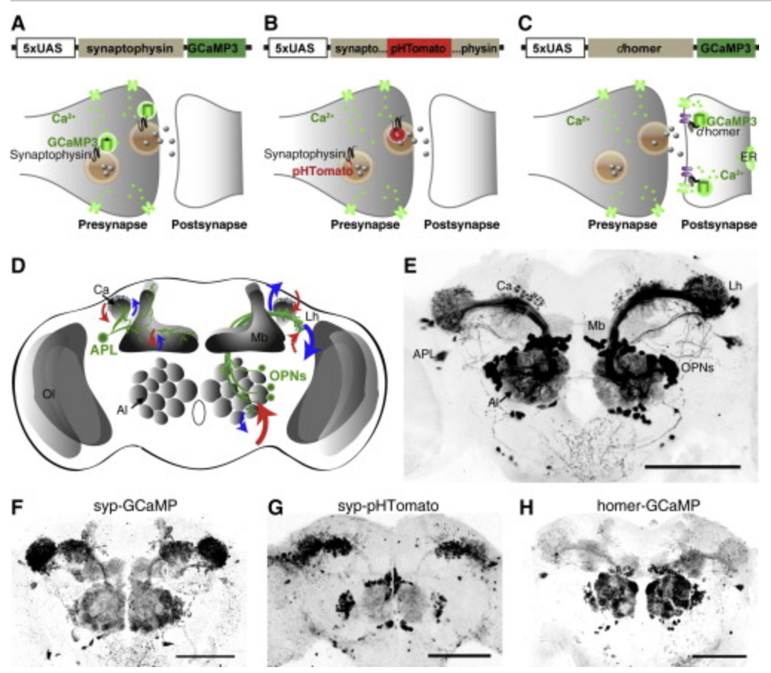
Genetically encoded calcium indicators (GECI)
Pech et al., 2015 Cell Rep

Slide 16
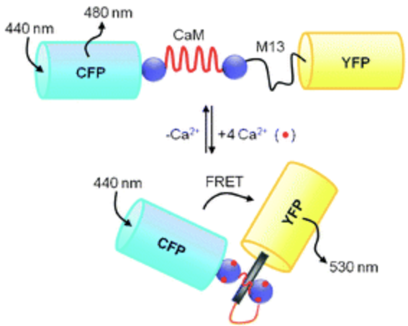
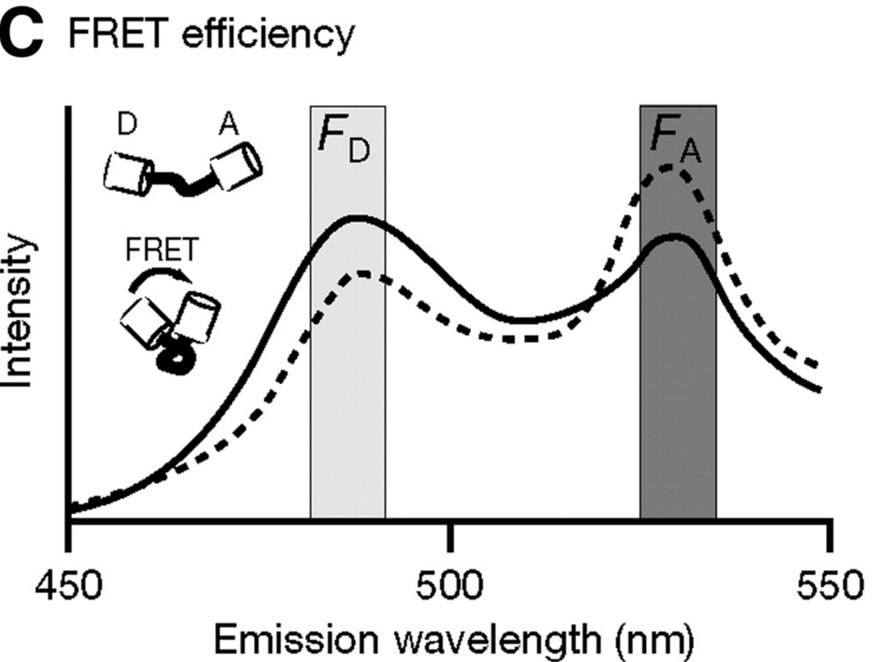
Forster Resonance Energy Transfer (FRET)
Yellow cameleon (yc#, e.g., YC3.6)
D3cpV (swaps out for Venus)
TN-XXL (swaps out for Troponin C)
Measure:
R = I_{A}/I_{D}
△R/R₀
Ko et al., 2010 Chem Soc Rev
Notes:
16

Slide 17
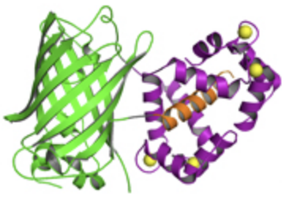
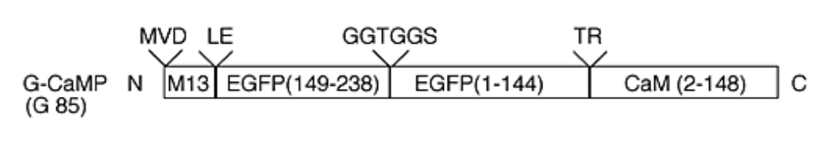
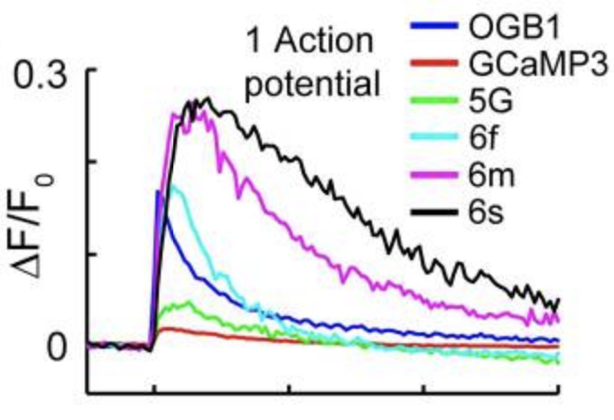
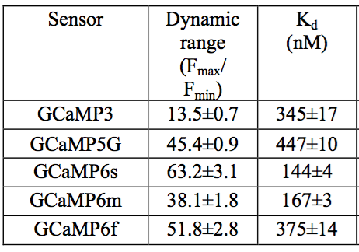
GCaMP
GFP
Calcium
M13
CaM
Original GCaMP K_{d}(Ca²⁺) ~ 235nM
Nakai et al., 2001 Nat Biotech
0
1
2
3
Time (s)
Chen et al., 2013 Nature

Slide 18
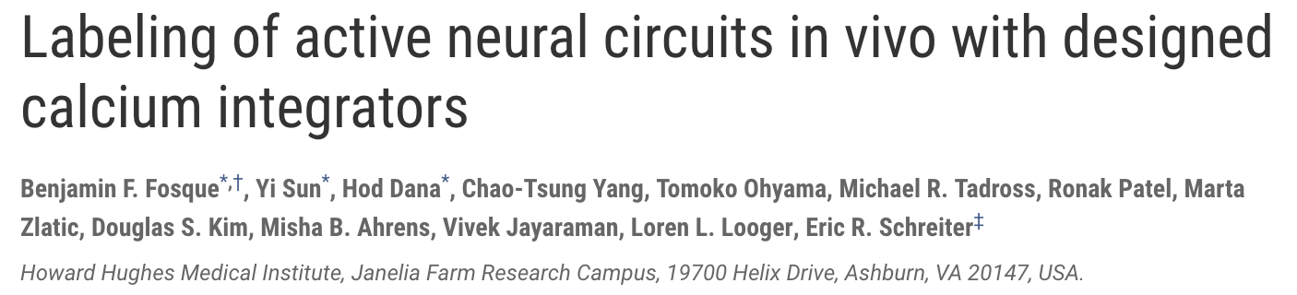
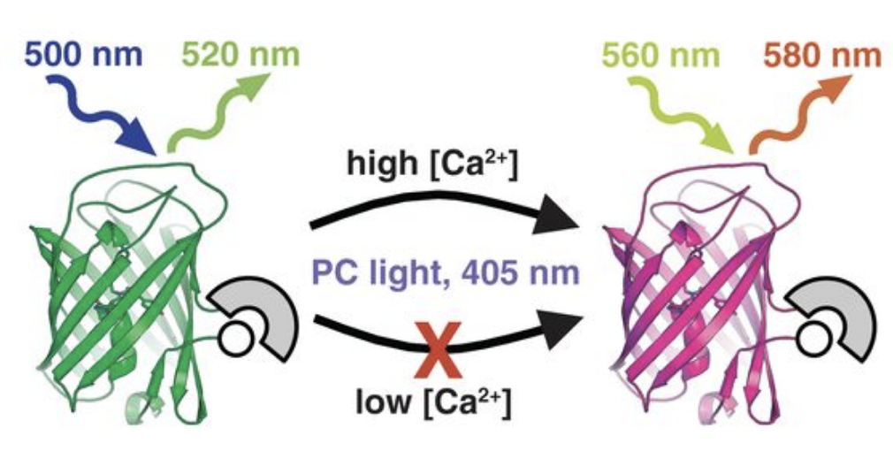
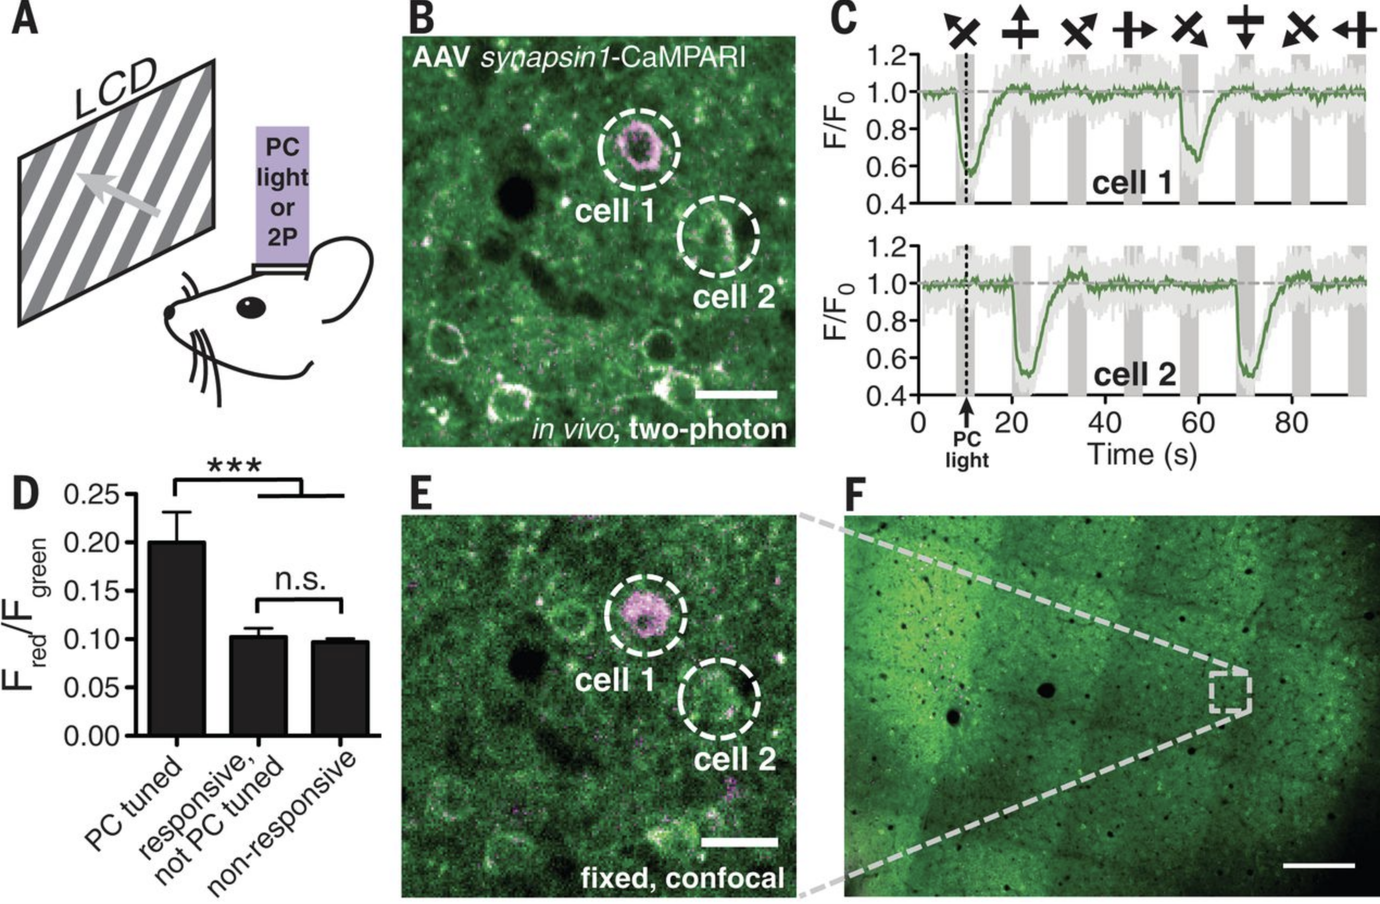
Science 2015

Slide 19
Instrumentation
Fluorescence detection system
1) Fluorophore
2) Wavelength filters
3) Detector
4) Excitation source
Types of fluorescence instruments
1) Fluorescence microscope
2) Spectrophotometer
3) Flow cytometer

Slide 20
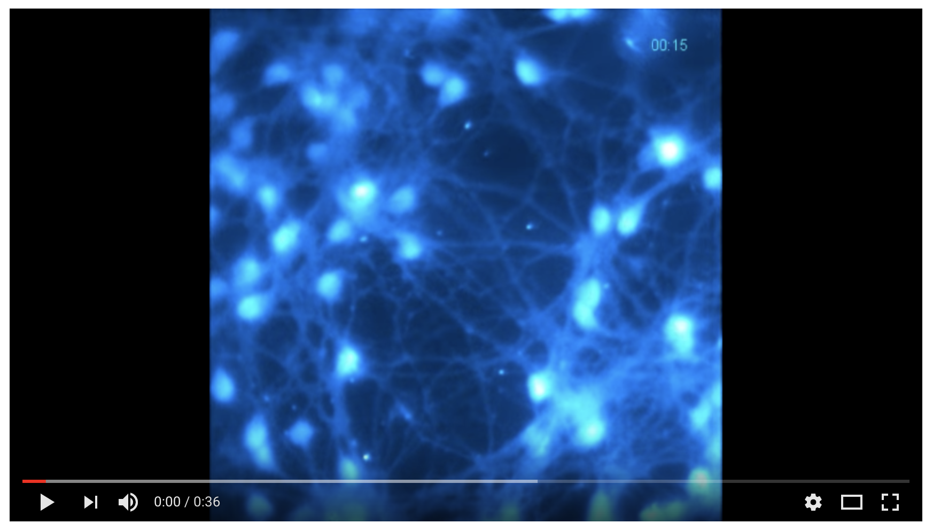
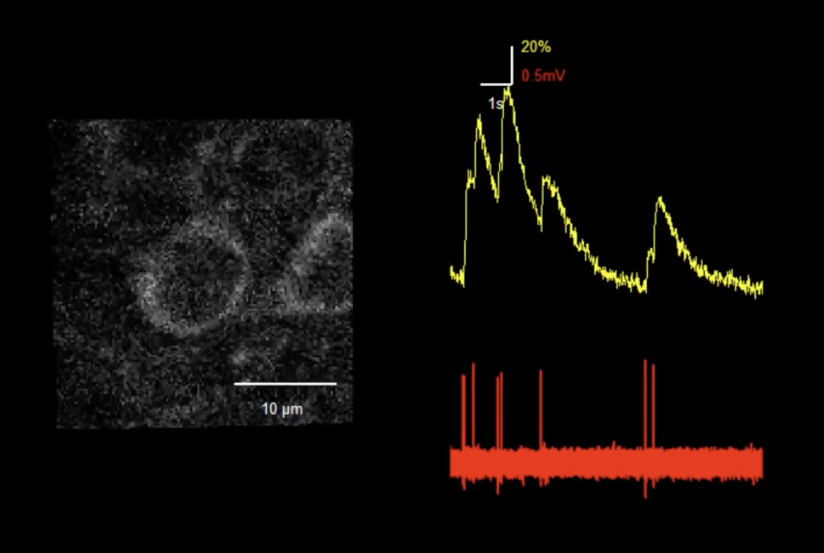
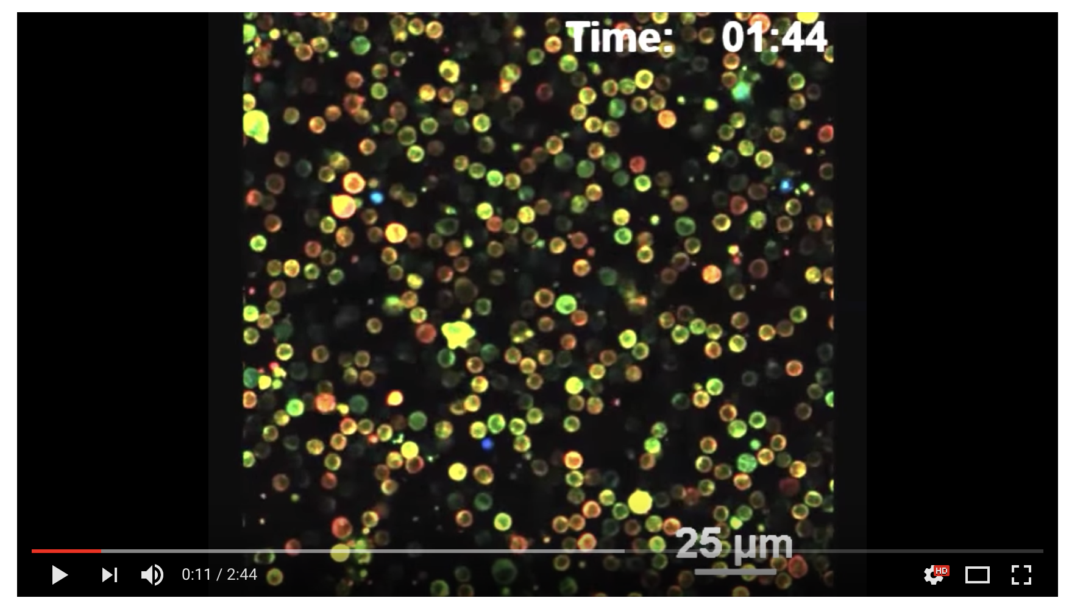
Fura-2 in culture
GCaMP6s in visual cortex
D3cpV in mouse lymphcytes

Slide 21
Troubles/Innovations

Slide 22
Potential Problems of Ca²⁺ Indicators
Intracellular Buffering
Cytotoxicity
Autofluorescence
Bleaching
Compartmentalization
Binding to Other Ions and Proteins
Dye Leakage

Slide 23
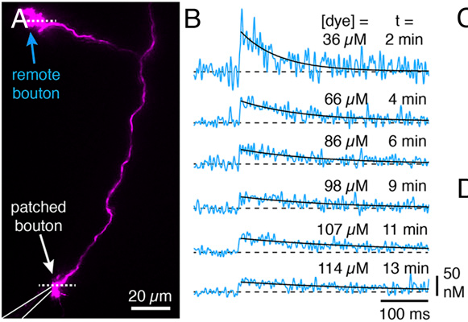
Diffusion of the Sensor
Remote bouton
10 uM Atto594
200 uM Fluo-5F
Igor Delvendahl et al. PNAS 2015;112:E3075-E3084

Slide 24

Calcium Binding Ratio
Buffering capacity (κ)
κ = Bound Ca²⁺/Free Ca²⁺
Higher kappa means less free calcium
Cultured hippocampal neuron 57-60
Cultured hippocampal interneuron 130-150
Lee et al, 2000
CA1 pyramidal spine 14-22
CA1 pyramidal dendrite 28-32
(Sabatini et al, 2002)
Cortical pyramidal neuron spine 19
Cortical pyramidal neuron dendrite 62
(Cornelisse et al, 2007)

Slide 25
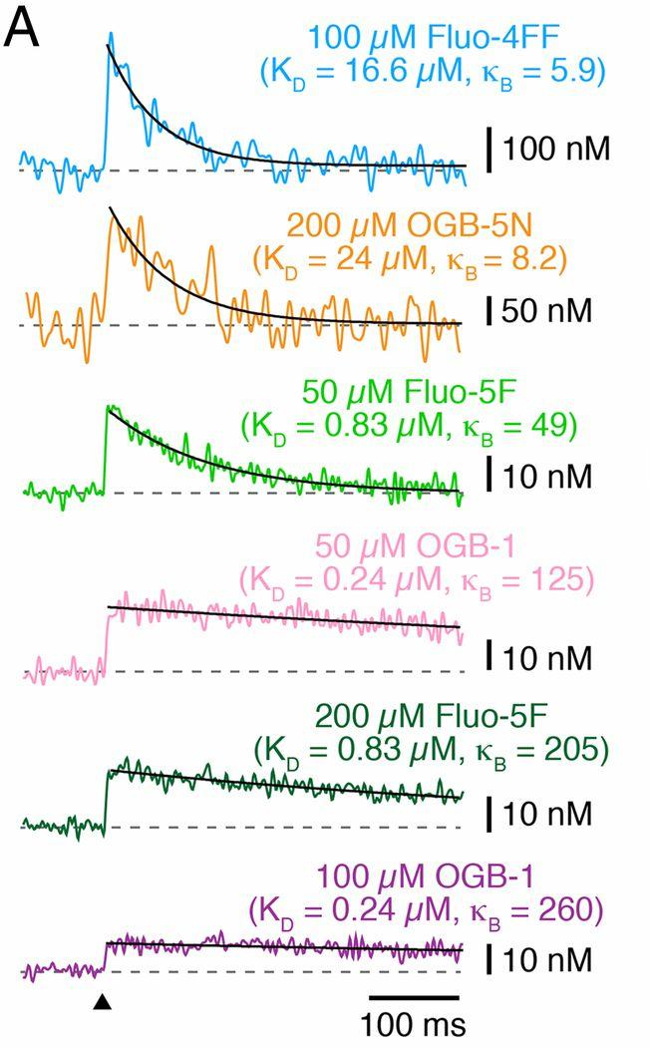
Using Indicators with Different Ca²⁺ Binding Ratios
Buffering Capacity
κ=[B]/K_{D}
Igor Delvendahl et al. PNAS 2015;112:E3075-E3084

Slide 26
Potential Problems of Ca²⁺ Indicators
Intracellular Buffering
Cytotoxicity
Autofluorescence
Bleaching
Compartmentalization
Binding to Other Ions and Proteins
Dye Leakage

Slide 27
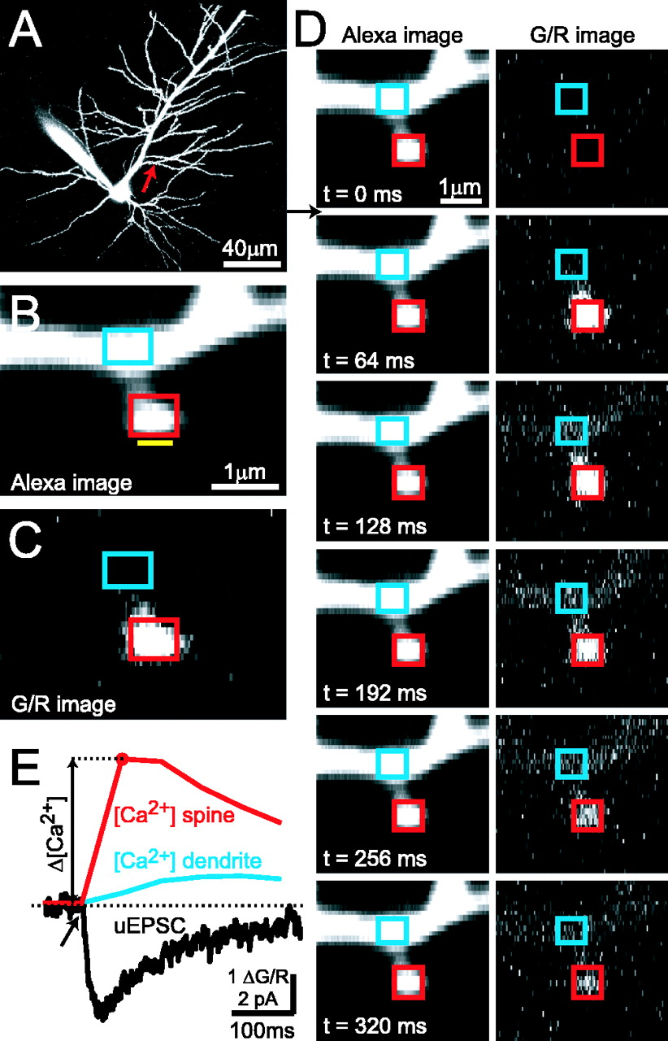
[Ca2+] imaging in single dendritic spines.
Simultaneous two-photon glutamate uncaging and two-photon [Ca2+] imaging in single dendritic spines.
Aleksander Sobczyk et al. J. Neurosci. 2005;25:6037-6046
Notes:
27

Slide 28
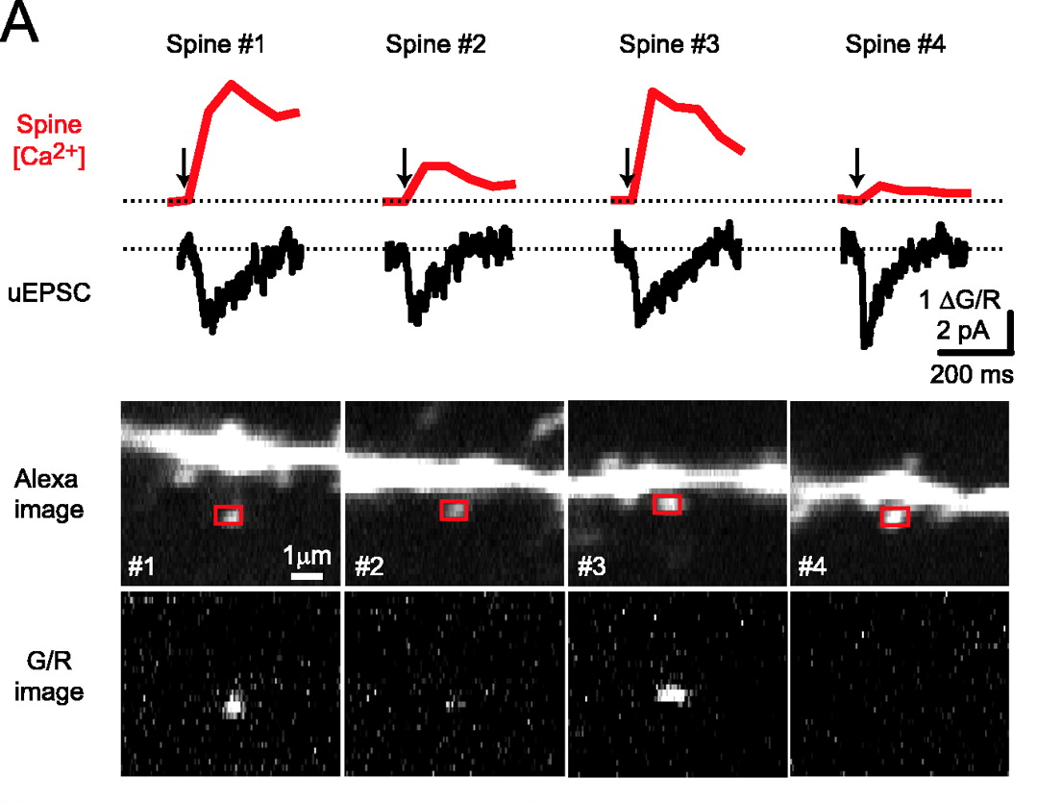
Individual dendritic spines are different
Heterogeneity in [Ca2+] signals across individual dendritic spines.
Aleksander Sobczyk et al. J. Neurosci. 2005;25:6037-6046
Notes:
28

Slide 29
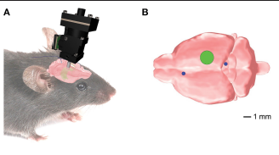
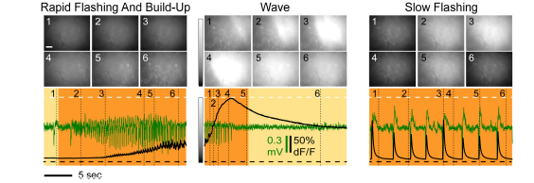
Awake-behaving
Mice treated with viral vector to express GCaMP6f
Record EEG and hippocampal calcium dynamics +/- kainic acid (KA)
Berdyyeva et al, 2016

Slide 30
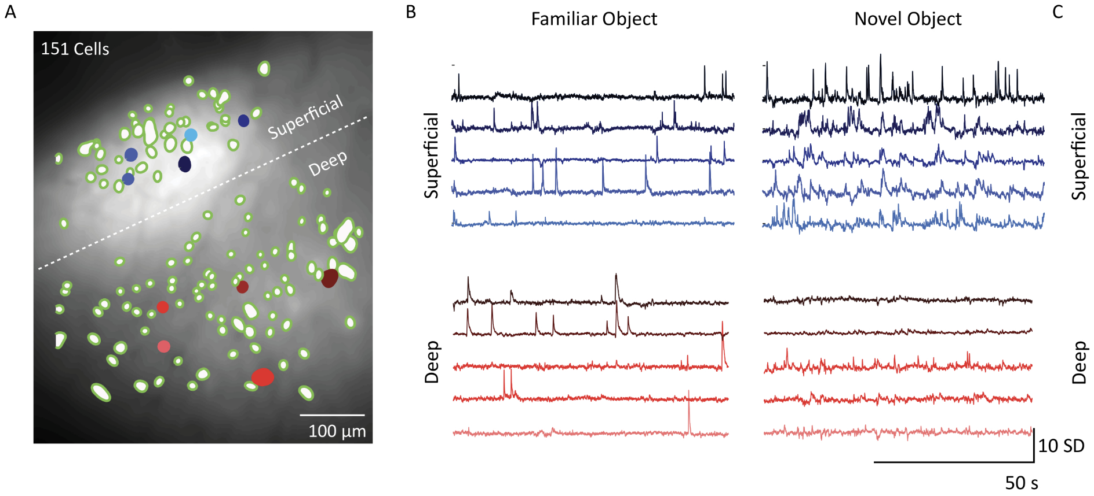
GCaMP6f (viral)
Multilayer cortical calcium imaging in freely moving mice with prism probes and miniaturized fluorescence microscopy
Gulati et al., 2017 JoVE

Slide 31
Objectives
What are the roles of CA in the cell?
How are CA levels regulated in the cell?
Entry/removal
Buffering
What are tools we have for visualizing CA levels and dynamics in vivo?
Types of indicators
Pros/Cons
How to read the data

